Slide 1

Decision-Making Report: AI Tool Usage by Indian College Students – 2025
¹ Based on Kaggle Dataset h Research Notes
Presented by P. Yuvaratna Reddy | 6,Sep,2025

Slide 2
Problem Statement
With the rise of AI tools like ChatGPT, Gemini, and Copilot, students are increasingly using them for studies, projects, and assignments. However, educators and institutions have limited visibility into how students are using AI, what devices they rely on, how it affects their grades, and whether students are aware and willing to pay for these tools. This dashboard aims to analyze students’ AI usage patterns, trust levels, and impact on learning outcomes to provide insights for decision-making in education.
Report Objective
To analyze AI tool usage patterns across various academic
Data Sources
Insights are derived from a comprehensive Kaggle dataset focusing on AI adoption trends, supplemented by qualitative research analysis.
streams, years of study, and assess students' willingness to pay for these tools.

Slide 3
Context h Objective
Why AI Adoption Matters Now
In 2025, AI is rapidly transforming industries. Integrating AI into higher ed is crucial for preparing students for the future workforce. Understanding how Indian college students are adopting and using AI tools provides insights for policymakers, admins, and educators. This report aims to shed light on current trends and inform strategic decisions for AI integration..
Report Objective
To analyze AI tool usage patterns across various academic
Data Sources
Insights are derived from a comprehensive Kaggle dataset focusing on AI adoption trends, supplemented by qualitative research analysis.
streams, years of study, and assess students' willingness to pay for these tools.

Slide 4






Our Decision-Making Framework
To provide a understanding of AI adoption, we structured our analysis around five key decision factors, allowing for a multifaceted view of student engagement with AI.
Top 5 Streams
Purpose of AI
Use cases driving adoption
Academic disciplines and concentrations
Willingness to Pay
Top 5 Colleges
Year of Study
Impact of academic progression
Students' payment intent
Institutional distribution of students

Slide 5
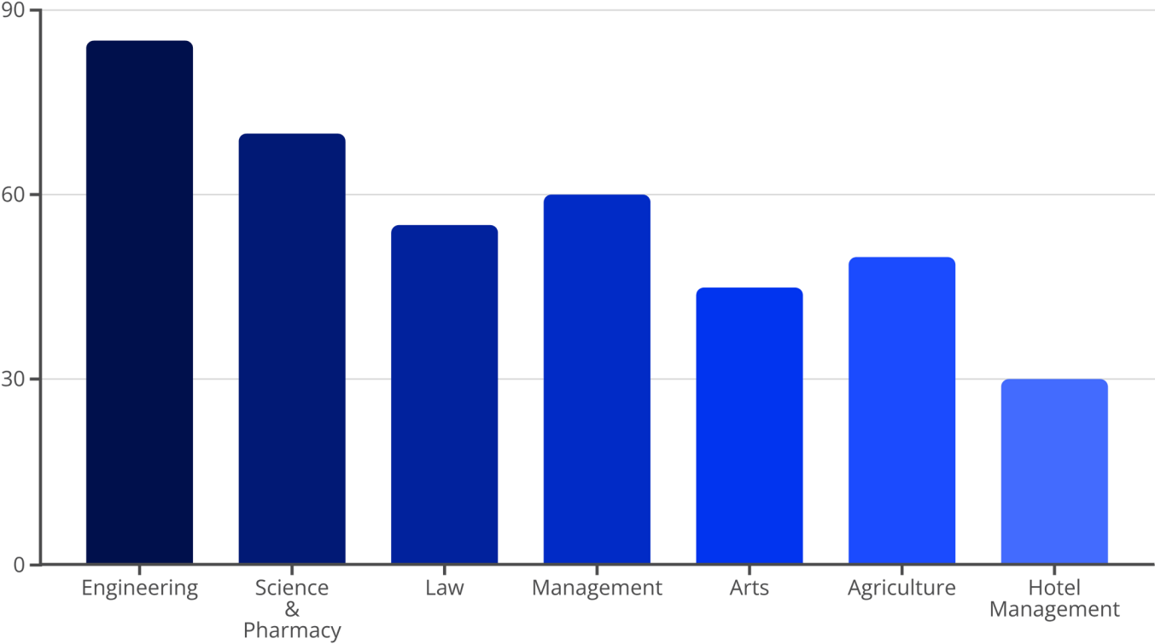
AI Adoption Rates by Academic Stream
AI tool usage varies significantly across different academic disciplines, reflecting diverse needs and applications. Engineering students show
the highest adoption, primarily for skill development, while Hotel Management sees the lowest current usage.

Slide 6
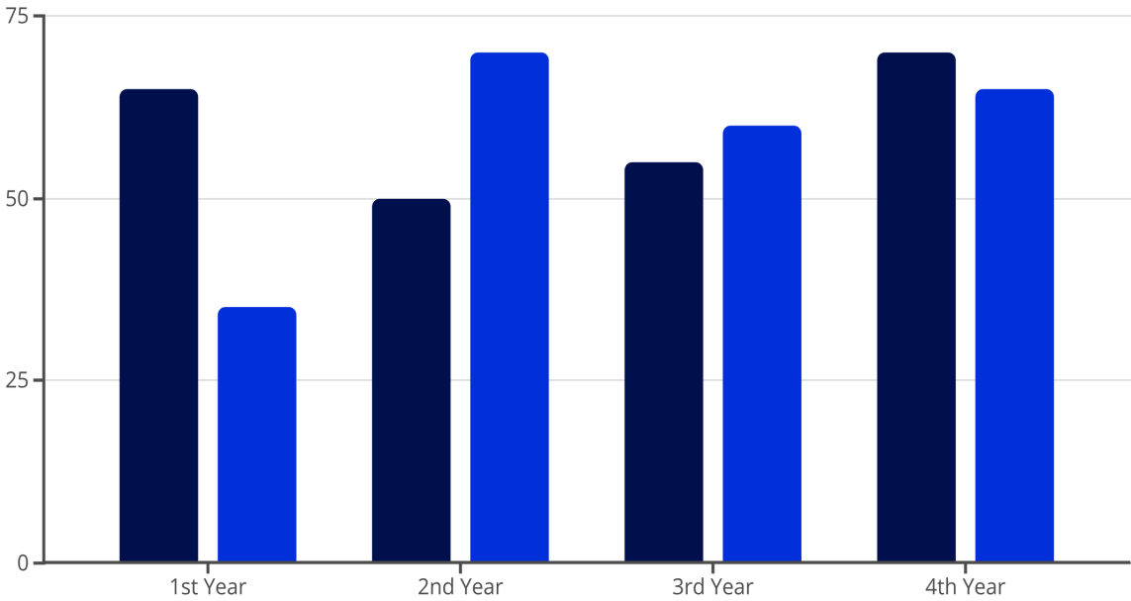


AI Adoption by Year of Study
Student engagement with AI tools evolves throughout their academic journey, from foundational skill development in the first year to balanced usage
for career preparation in the final year.
Skill Development (%)
Daily Usage (%)
This progression suggests that curricula can be tailored to introduce AI tools in a phased manner, aligning with student needs at each stage.

Slide 7
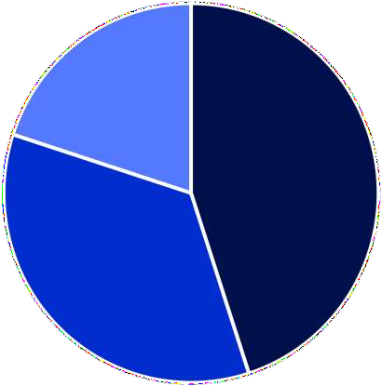



Primary Purpose of AI Tool Usage
Students primarily leverage AI for enhancing their skills and supporting their studies, with a growing trend towards daily integration for various tasks.
Skill Development
Study Support
Daily Usage
Engineering and Management students lead in AI for skill development, while Science, Pharmacy, and Medical students heavily rely on AI for study support. Arts and Commerce students show moderate daily usage.

Slide 8
Leading Institutions in AI Adoption
Certain institutions demonstrate higher rates of AI tool adoption among their students, indicative of strong digital infrastructure and potentially curriculum integration.
National Institute of Technology
Indian Institute of Management
Symbiosis Institute of Technology
Institute of Hotel Management
Indian Institute of Information Technology
These institutions can serve as case studies for best practices in fostering AI literacy and adoption.

Slide 9
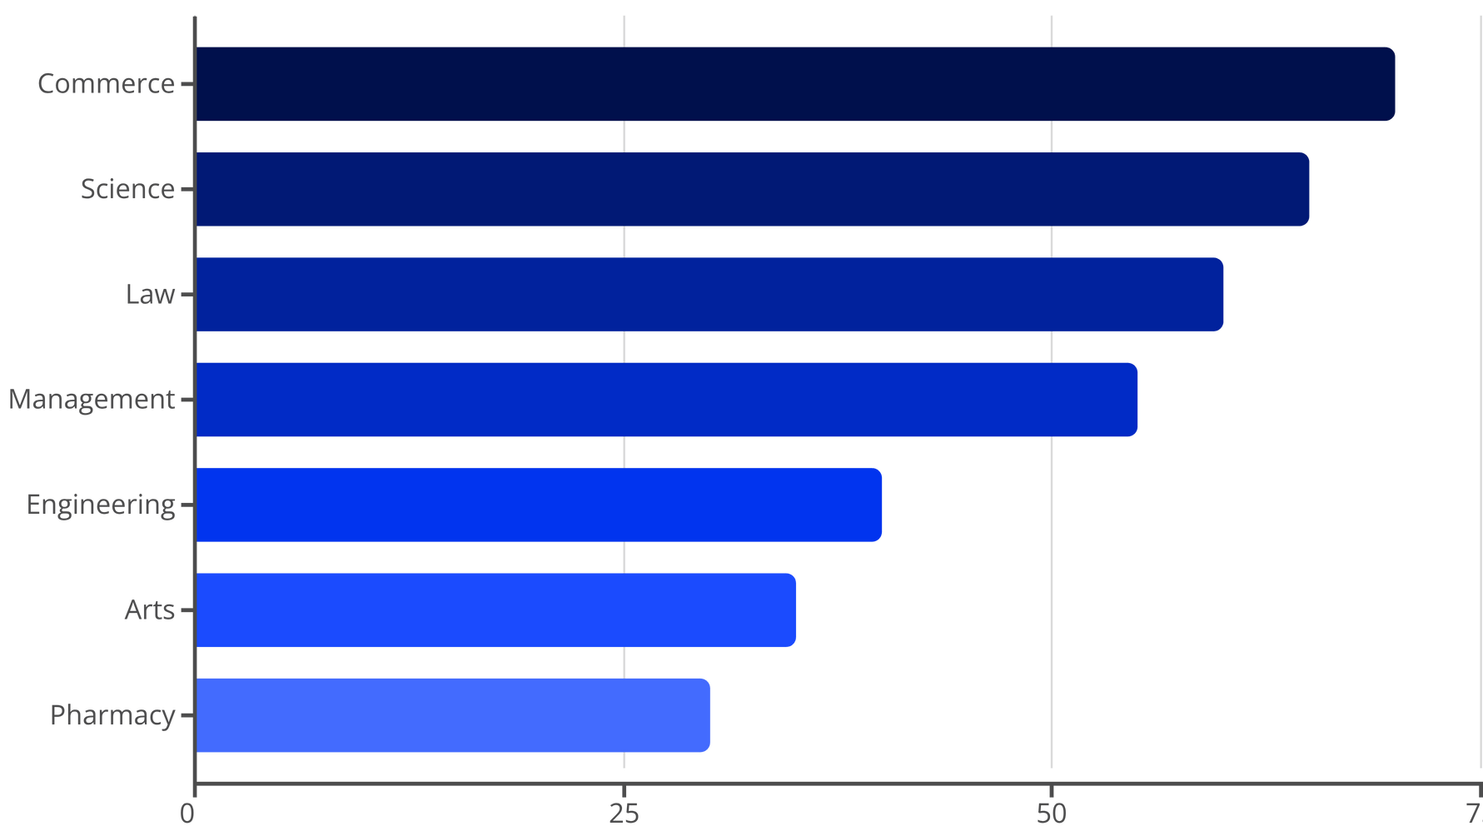
Willingness to Pay for AI Tools
A critical aspect of AI tool sustainability is students' willingness to pay. While some streams show higher readiness, a significant portion of students still prefer free AI
tools, posing an affordability challenge for broader adoption.
9

Slide 10




Key Decision-Making Insights
Our analysis reveals clear patterns and trends that can inform strategic decisions regarding AI integration in Indian higher education.
Purpose-Driven Adoption
Stream h Year Influence
AI tools are predominantly used for skill development and academic study support, indicating a practical, utility-driven approach by students.
The academic stream and year of study significantly influence the type and intensity of AI tool usage, requiring tailored educational approaches.
Affordability Challenge
Growth Potential
Willingness to pay for AI tools remains low in several key streams, highlighting the need for affordable or subsidized solutions.
Significant growth in AI adoption is expected within Commerce, Science, and Management streams as awareness and applications expand.
These insights serve as a foundation for developing targeted strategies to maximize AI's benefits in education.

Slide 11
Conclusion & Recommendations
The findings underscore the dynamic landscape of AI adoption in Indian colleges. Strategic interventions are necessary to ensure equitable access and maximize the benefits of AI for all students.
"AI adoption is growing, but affordability and awareness are key to unlocking its full potential across all academic disciplines."
Ensure Accessibility
Students need access to affordable and user-friendly AI tools. Collaborations with AI developers for educational licenses or subsidized access could bridge the gap.
Integrate AI Learning
Targeted actions
Given the uneven adoption, targeted awareness campaigns and training programs are needed, especially for streams with lower current usage.
Colleges should proactively integrate AI learning programs into their curricula, fostering both theoretical understanding and practical application across all streams.

